Slide 1
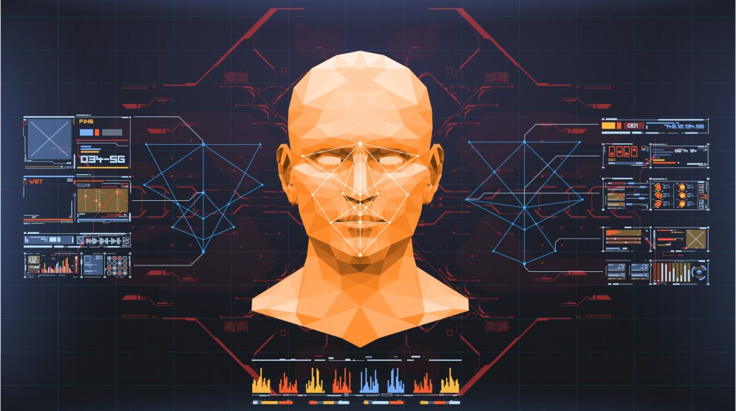
Face Recognition Attendance System

Slide 2
MADE BY:-
NAME:- BALA KRISHNA CHENNAIAH
REGD NO. :- 121912501006
CLASS:- BCA-3/3 – ‘A’
GUIDE NAME:- MRS. B SATYA SAI VANI

Slide 3
REQUIREMENT ANALYSIS DOCUMENT:-

Slide 4
1. INTRODUCTION:
Every organization requires a robust and stable system to
record the attendance of their students and every
organization have their own method to do so, some are
taking attendance manually with a sheet of paper by
calling their names during lecture hours and some have
adopted biometrics system such as fingerprint, RFID card
reader, Iris system to mark the attendance.

Slide 5
1.1.PURPOSE of the System
Instead of using the conventional methods, this proposed system aims to develop an automated system that records the student's attendance by using facial recognition technology. The main objective of this work is to make the attendance marking and management system efficient, time saving, simple and easy.

Slide 6
1.2.SCOPE of the System
The main objective of this project is to offer system that simplify and automate the process of recording and tracking students' attendance through face recognition technology.
It is biometric technology to identify or verify a person from a digital image or surveillance video.

Slide 7
1.3.OBJECTIVE AND SUCCESS CRITERIA OF THE SYSTEM
Instead of using the conventional methods, this proposed system aims to develop an automated system that records the student's attendance by using facial recognition technology.
The main objective of this work is to make the attendance marking and management system efficient, time saving, simple and easy.

Slide 8
1.4.REFERENCES:
[1] ttps://www.researchgate.net/publication/326261079_Face_detection_
system_for_attendance_of_class’_students
[2] Hapani, Smit, et al. "Automated Attendance System Using Image
Processing." 2018 Fourth International Conference on Computing
Communication Control and Automation (ICCUBEA). IEEE, 2018.
[3] Akbar, Md Sajid, et al. "Face Recognition and RFID Verified
Attendance System." 2018 International Conference on Computing,
Electronics & Communications Engineering (iCCECE). IEEE, 2018.

Slide 9
[4] Okokpujie, Kennedy O., et al. "Design and implementation of a
student attendance system using iris biometric recognition." 2017
International Conference on Computational Science and
Computational Intelligence (CSCI). IEEE, 2017.
[5] Rathod, Hemantkumar, et al. "Automated attendance system using
machine learning approach." 2017 International Conference on
Nascent Technologies in Engineering (ICNTE). IEEE, 2017.
[6] Siswanto, Adrian Rhesa Septian, Anto Satriyo Nugroho, and
Maulahikmah Galinium. "Implementation of face recognition
algorithm for biometrics based time attendance system." 2014
International Conference on ICT For Smart Society (ICISS). IEEE,
2014.

Slide 10
[7] Lukas, Samuel, et al. "Student attendance system in classroom using
face recognition technique." 2016 International Conference on
Information and Communication Technology Convergence (ICTC).
IEEE, 2016.
[8] https://becominghuman.ai/face-detection-using-opencv-with-haar-
cascade-classifiers-941dbb25177
[9] https://www.superdatascience.com/blogs/opencv-face-recognition
[10] Salim, Omar Abdul Rhman, Rashidah Funke Olanrewaju, and Wasiu
Adebayo Balogun. "Class attendance management system using face
recognition." 2018 7th International Conference on Computer and
Communication Engineering (ICCCE). IEEE, 2018.

Slide 11
2.CURRENT SYSTEM:
Traditional attendance marking techniques i.e, pen and paper or signing attendance sheets are easy to bypass and trick as giving proxies or false signatures is a common practice among students nowadays, students take an unfair advantage of this at most times. But a facial recognition system is unassailable and cannot be fooled as each person has a set of unique and individual features common to that person and cannot be replicated or changed, it all comedown to one simple truth that is, unless you are physically present in the lecture your attendance will not get marked.

Slide 12
3.PROPOSED SYSTEM:
In the proposed system, initially all the students will be registered in the system using name and ID and after that there multiple face images are collected using a camera and are Stored in a folder(database).
And after that registered student can give attendance by standing in front of the camera.
The attendance will be marked for the students those who gave their attendance by coming in front of the camera.
The attendance record(different for different dates) and Students record will be saved in an CSV file.

Slide 13
3.1.OVERVIEW:
Face recognition involves two steps, first step involves the detection of faces and second step consist of identification of those detected face images with the existing database.

Slide 14
3.2.Functional Requirements:
Taking and tracking student attendance by facial recognition in specific time.
Teacher able to access names of the students who are present.
Permitting the lecturer to modify the student attendance record.
Able to register new student into the database or remove the existing student from the data base.

Slide 15
3.3.Non-functional requirements:
Accuracy and Precision: the system should perform its process in accuracy and Precision to avoid problems.
Modifiability: the system should be easy to modify, any wrong should be correct.
Security: the system should be secure and saving student’s privacy.
Usability: the system should be easy to deal with and simple to understand.
Maintainability: the maintenance group should be able to fix any problem occur suddenly.
Speed and Responsiveness: Execution of operations should be fast.

Slide 16
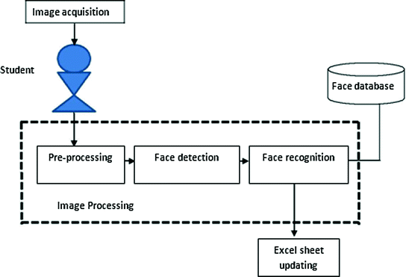
3.4.SYSTEM MODEL:

Slide 17
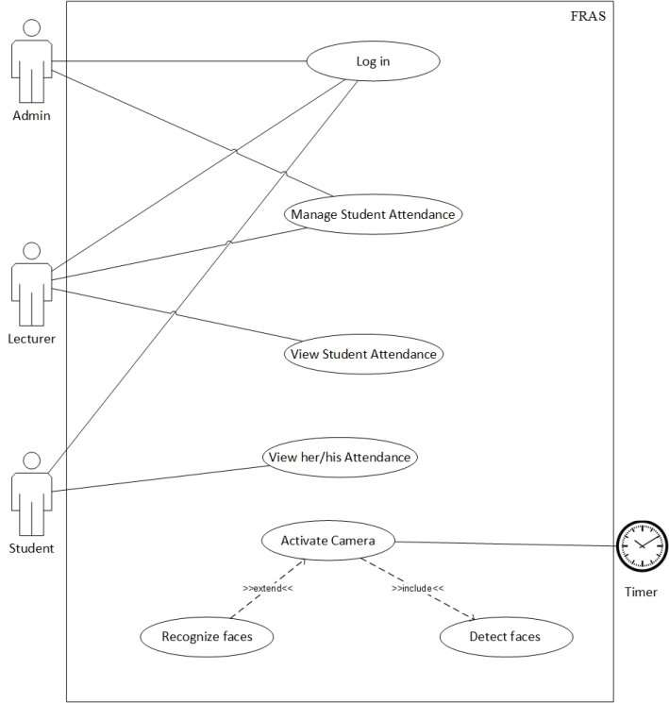
Use case diagram :

Slide 18
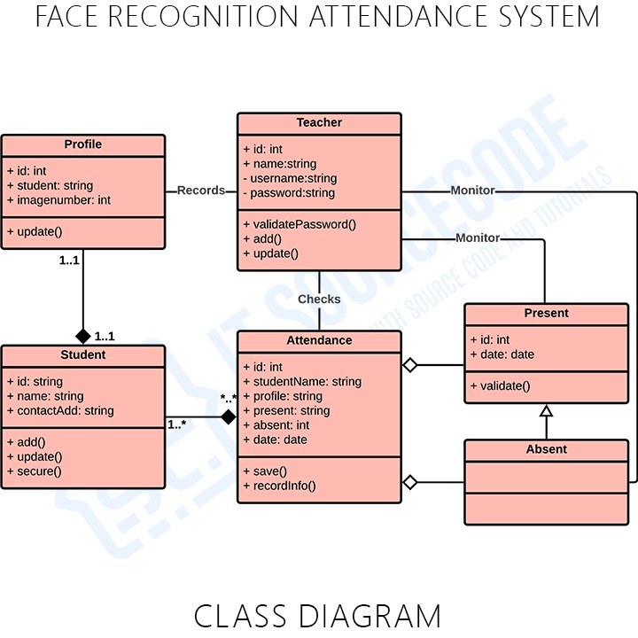
Class diagram

Slide 19
System Design Document

Slide 20
1. Introduction
The system is developed for deploying an easy and a secure way of taking down attendance. The software first captures an image of all the authorized persons and stores the information into database. The system then stores the image by mapping it into a face coordinate structure. Next time whenever the registered person enters the premises the system recognizes the person and marks his attendance along with the time.

Slide 21
1.1.Purpose of the system
Instead of using the conventional methods, this proposed system aims to develop an automated system that records the student's attendance by using facial recognition technology. The main objective of this work is to make the attendance marking and management system efficient, time saving, simple and easy.

Slide 22
1.2.Design Goals
Accessibility
Usability
Fit for Purpose
Reusability
User Friendly

Slide 23
1.3.References
[1] ttps://www.researchgate.net/publication/326261079_Face_detection_
system_for_attendance_of_class’_students
[2] Hapani, Smit, et al. "Automated Attendance System Using Image
Processing." 2018 Fourth International Conference on Computing
Communication Control and Automation (ICCUBEA). IEEE, 2018.
[3] Akbar, Md Sajid, et al. "Face Recognition and RFID Verified
Attendance System." 2018 International Conference on Computing,
Electronics & Communications Engineering (iCCECE). IEEE, 2018.

Slide 24
[4] Okokpujie, Kennedy O., et al. "Design and implementation of a
student attendance system using iris biometric recognition." 2017
International Conference on Computational Science and
Computational Intelligence (CSCI). IEEE, 2017.
[5] Rathod, Hemantkumar, et al. "Automated attendance system using
machine learning approach." 2017 International Conference on
Nascent Technologies in Engineering (ICNTE). IEEE, 2017.
[6] Siswanto, Adrian Rhesa Septian, Anto Satriyo Nugroho, and
Maulahikmah Galinium. "Implementation of face recognition
algorithm for biometrics based time attendance system." 2014
International Conference on ICT For Smart Society (ICISS). IEEE,
2014.

Slide 25
[7] Lukas, Samuel, et al. "Student attendance system in classroom using
face recognition technique." 2016 International Conference on
Information and Communication Technology Convergence (ICTC).
IEEE, 2016.
[8] https://becominghuman.ai/face-detection-using-opencv-with-haar-
cascade-classifiers-941dbb25177
[9] https://www.superdatascience.com/blogs/opencv-face-recognition
[10] Salim, Omar Abdul Rhman, Rashidah Funke Olanrewaju, and Wasiu
Adebayo Balogun. "Class attendance management system using face
recognition." 2018 7th International Conference on Computer and
Communication Engineering (ICCCE). IEEE, 2018.

Slide 26
1.4.Overview
We can register a new a student in the student database by the using the password for registration of the new student.
A registered student can simply mark his or her attendance just by clicking on the button take attendance, and showing his/her face on the camera and then the system will identify the face and mark the attendance.

Slide 27

2.Current System Architecture
The current system of taking attendance is of pen and paper method where teachers use to call the names or roll number of the students and the students are supposed to answer present and if some one have not answered he or she will be simply marked absent. This method consumes time and often creates a chaos in the class during the time of attendance.

Slide 28
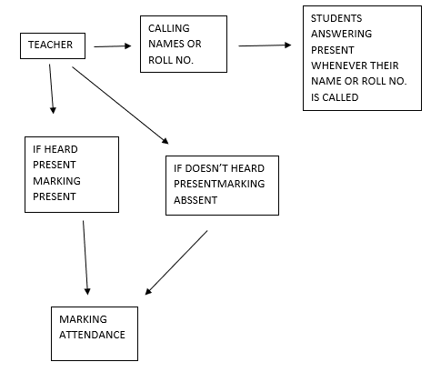
Teacher taking attendance in a class room

Slide 29
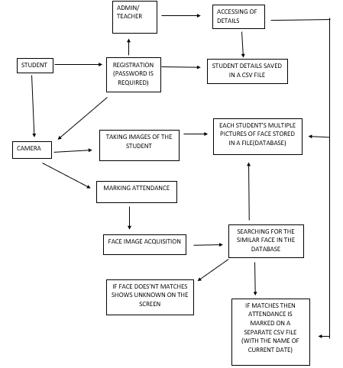
3.Proposed Software Architecture

Slide 30
3.1.Overview
When we run the program, a window will get opened. In it we can find certain options or buttons and text fields for different purposes.
We can register a new a student in the student database by the help of the admin who has the password for registration of the new student, while registering the system ask for the student to enter ID and name and after that system takes multiple images of the student and stores in a file(database).
A registered student can simply mark his or her attendance just by clicking on the button take attendance, and showing his/her face on the camera and then the system will identify the face and mark the attendance automatically in a CSV file(attendance recorded separately date wise).

Slide 31
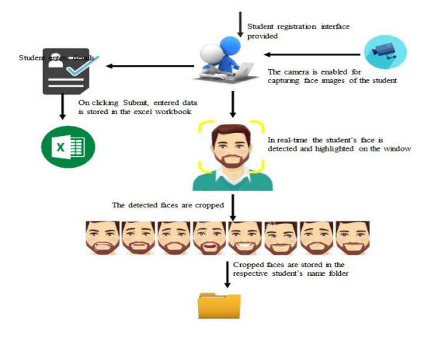
Working of Face Recognition attendance system

Slide 32
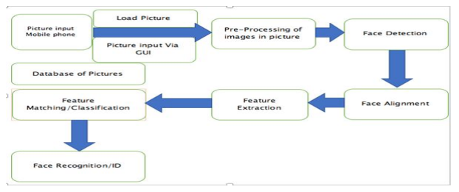
Face Detection and Recognition Flow Diagram

Slide 33
3.2.Persistent data mapping
The registered students data is stored in a CSV file.
And the Attendance of the students are marked too in a CSV file.
The attendance is marked for different dates in separate CSV files.

Slide 34
3.3.Access control and Security
The details of he students can only be accessed by the teachers or the admin.
For security there must be a password in the PC from which this project(System) is being executed.
And while registration of students a password is required which only the admin knows or the teacher, and that password can be changed accordingly by the admin/teacher.
This details can be accessed by the admin/teacher.

Slide 35
Sample screens:

Slide 36
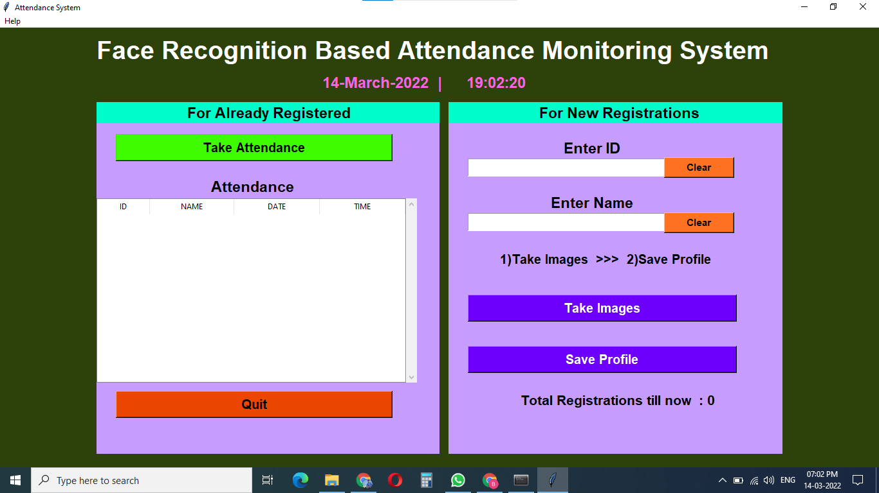
GUI OF THE SYSTEM(PROJECT)

Slide 37
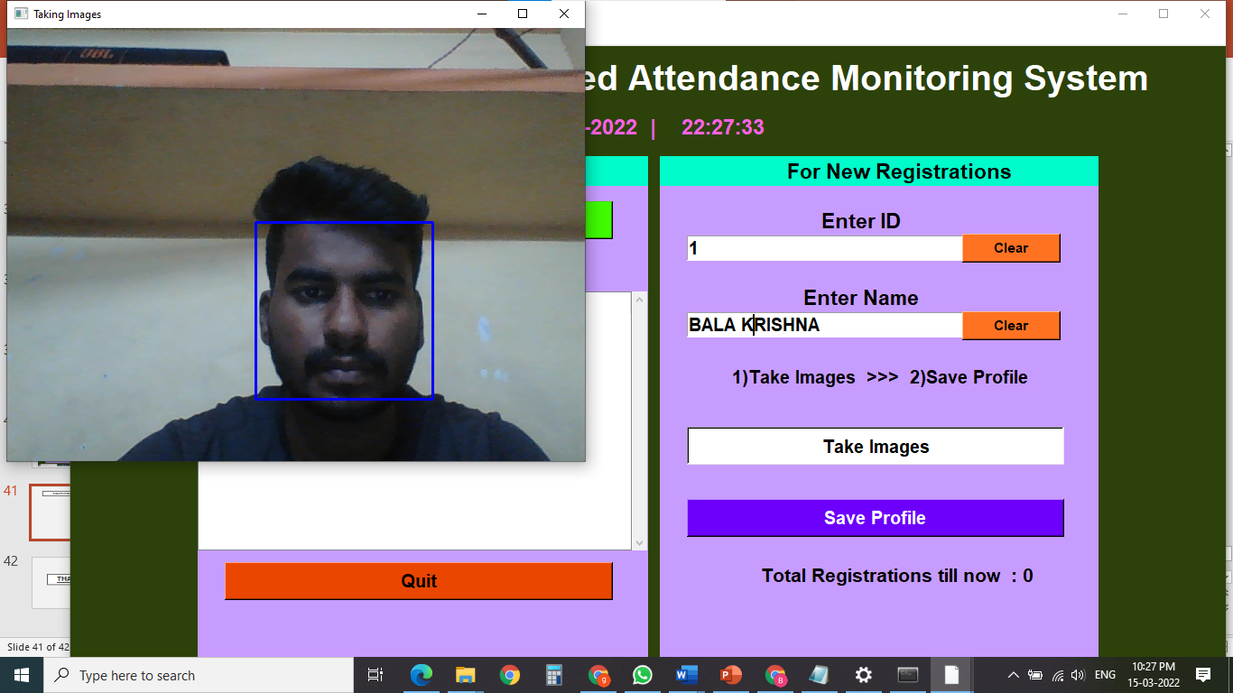
Registration of new student

Slide 38
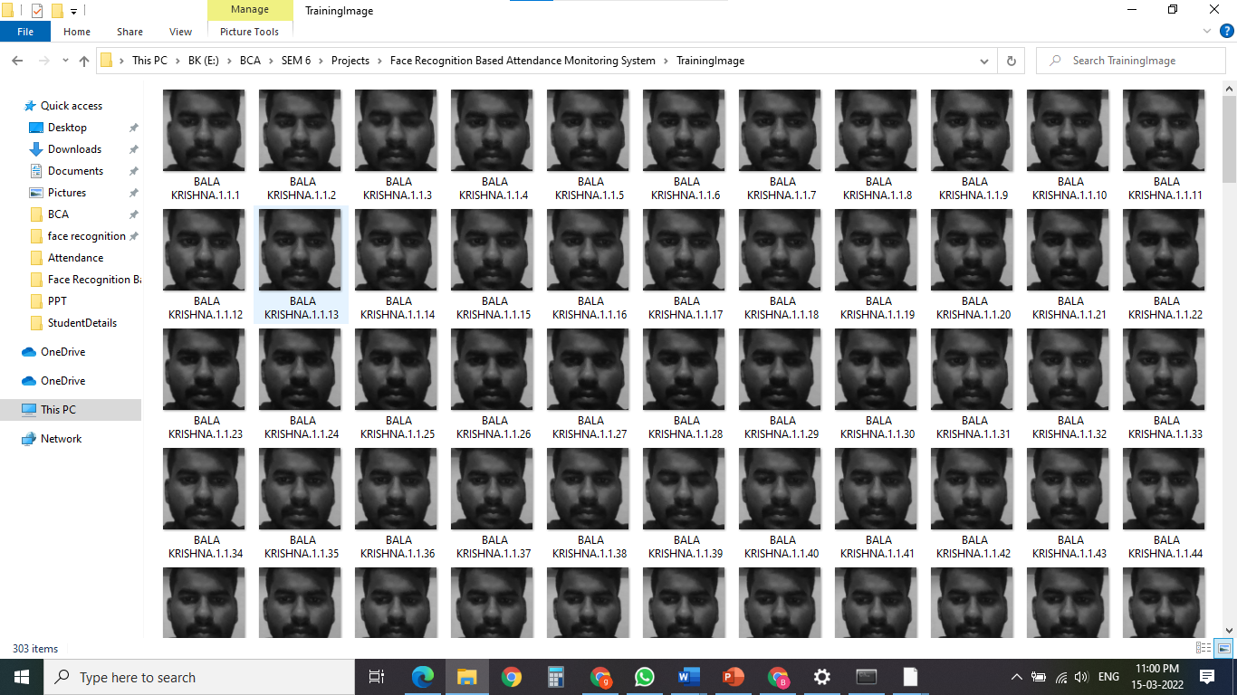
Training images

Slide 39
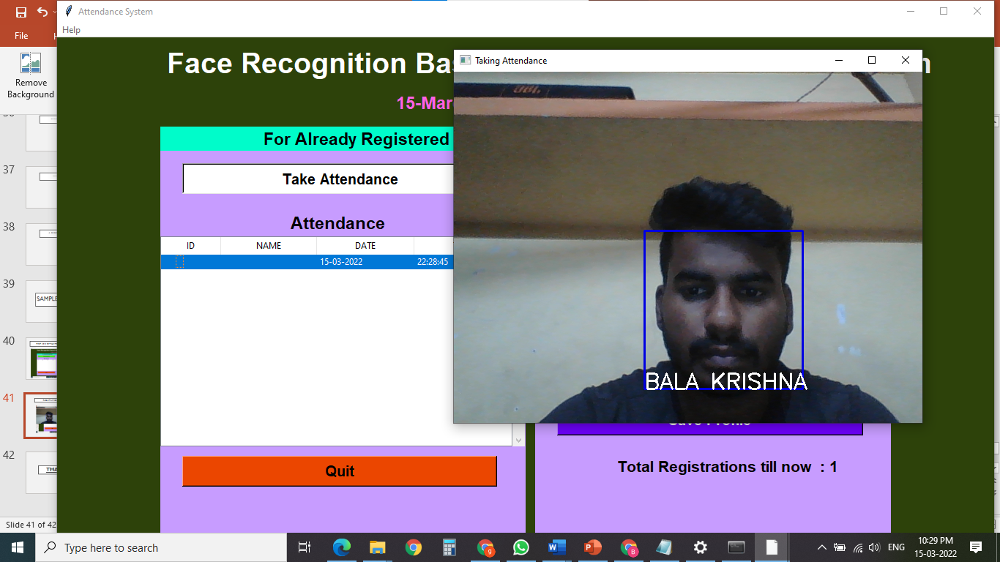
Taking attendance

Slide 40
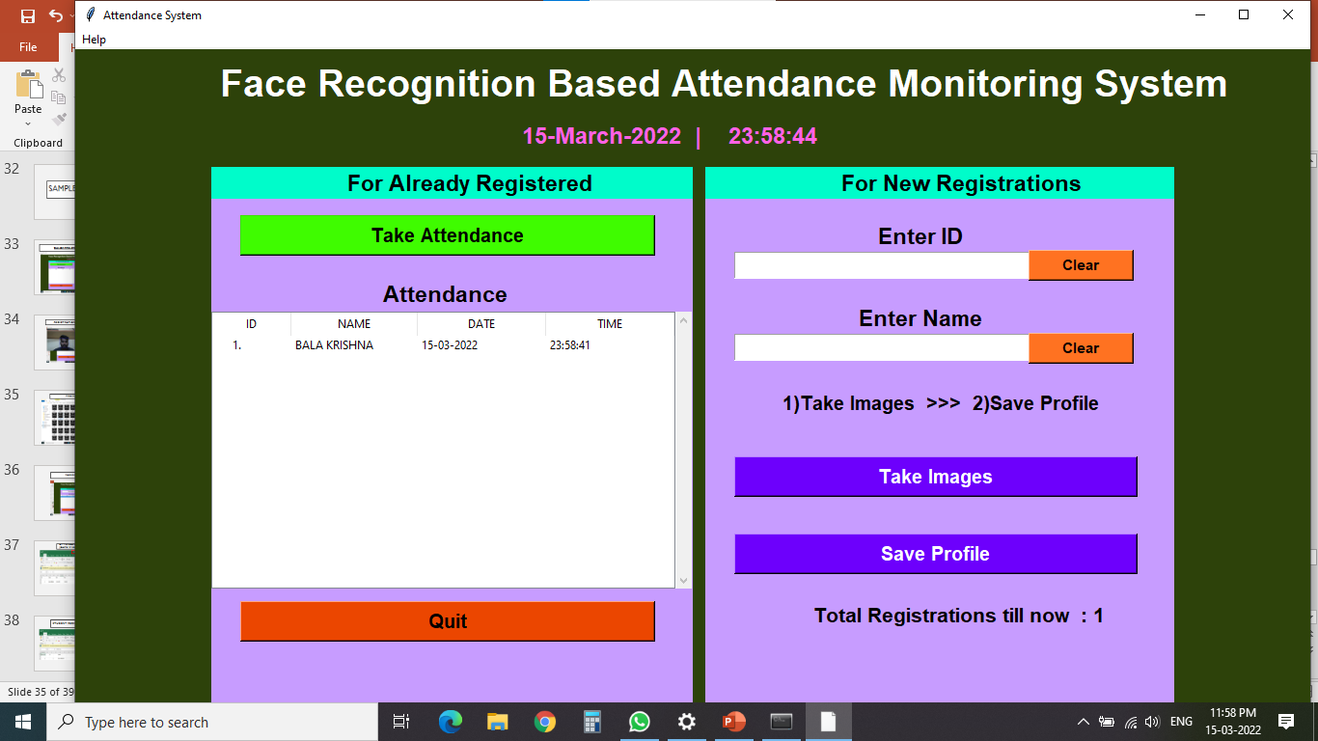
For students confirmation whether the attendance marked successfully

Slide 41
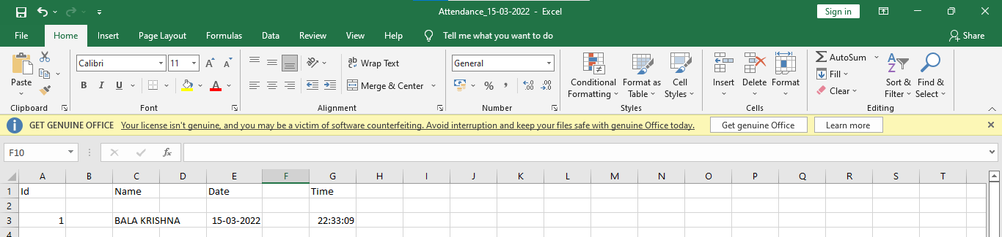
Attendance record (date wise separate)

Slide 42
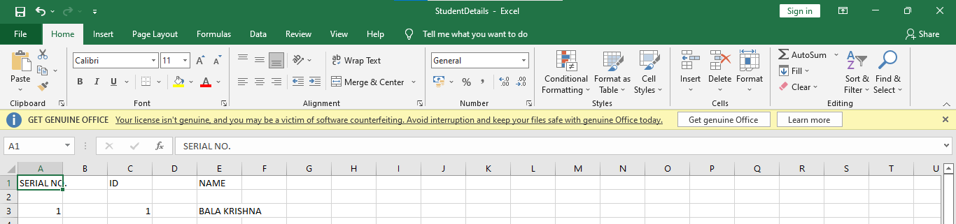
Student registration record

Slide 43
THANK YOU

